Slide 1




ANNUAL TEMPERATURE CHANGES IN U.S
Analyzing Annual Temperature Changes in the US: Impacts, Predictions, and Visualization
NGUGI JUSTIN
How temperature in the U.S has gradually changed overtime and has contributed to global warming and how it has affected various sectors of the U.S economy
BY NGUGI JUSTIN

Slide 2
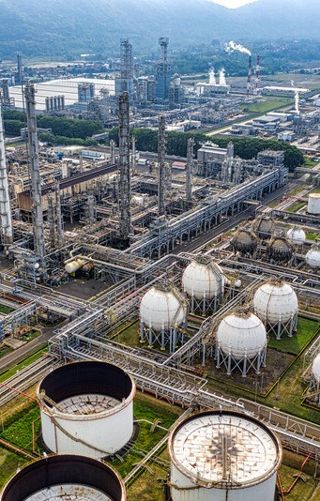
Overview
Introduction Data Sources
Explanatory Data Analysis GIS Integration
Machine Learning and Predictions Economic Impacts
Data Protection Measures Conclusion & Q/A
01
02
03
04
05
06
07
08

Slide 3






INTRODUCTION
OBJECTIVE
To analyze historical temperature trends in the US, assess their impacts on key economic sectors, and predict future changes using machine learning, providing insights for sustainable adaptation strategies.
RELEVANCE
The findings can help shape policies for climate change, improve farming practices, protect public health, and plan for energy needs. It also guides how we can adapt to and reduce the effects of climate change
SCOPE
These findings are based on past century data and future predictions for the U.S temperature

Slide 4

DATA OVERVIEW
DATA SOURCES
NATIONAL OCEANIC U.S CLIMATE DATA
https://www.ncdc.noaa.gov/cdo-web/datasets
NATURAL EARTH DATA
https://www.naturalearthdata.com/

Slide 5

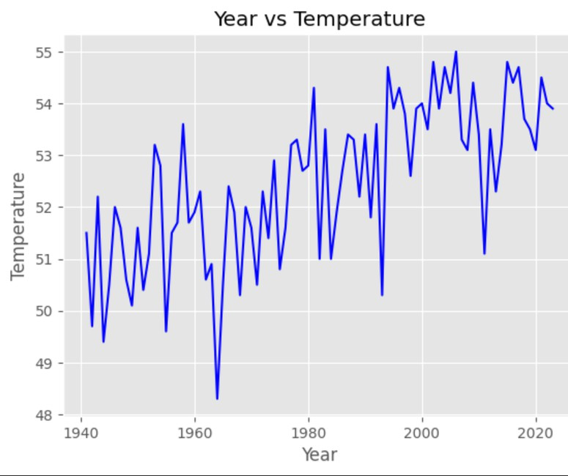
Temperature Trends
The graph shows a clear long-term increase in temperature over the decades with recent years consistently recording higher averages
Temperatures fluctuating up and down in the short term. This is due to due to natural climate variations
i.e ocean currents and solar variability
Average Temperature between the years 2024- 2000 (54.2) is higher than average between 1940-
2000(51.9)
05
Temperature trends from 1940-2023

Slide 6
The most Industialized areas in
N.Y (Central and Eastern) are experiencing the highest
temperature increase
Temperature changes aren't uniform across the state, suggesting local factors influence warming rates e.g
Indusrialization and Urbanisation

Slide 7



MACHINE LEARNING
Model Selection
Tried three different algorithms Linear Regression , Random Forest and Decision Tree Regressor
Placed the three different algorithms under a test using test data evaluating them based on metrics i.e MSE , r2 score
Model training and predictions
Random Forest was the best perfoming model among the three(81%) Trained the model and used it to make predictions on future temperature trends

Slide 8
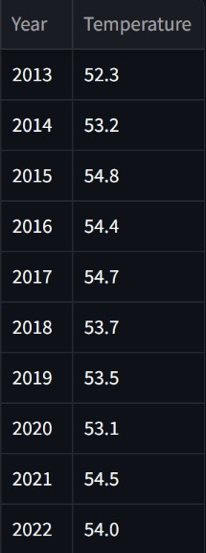
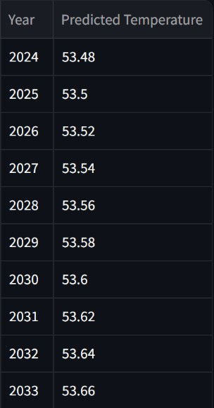
Temp over the past few years
Predicted Temp over the coming years
Temperature is predicted to increase gradually in the incoming years

Slide 9
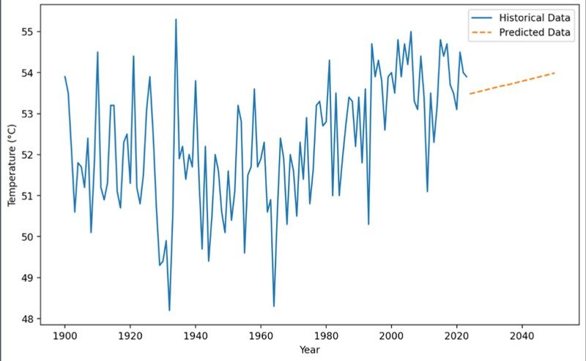
Ingoude Company
MACHINE LEARNING
Line Plot showing past and predicted trends in temperature over the next couple of years

Slide 10


How has temperature increase affected the economy of U.S?
@reallygreatsite
1. Agriculture
Rising temperatures have led to reduced crop yields and greater risks of droughts or heat stress on livestock
2. Health
Heatwaves lead to increased cases of heat- related illnesses i.e Heat Stroke and hospitalizations especially in vulnerable populations
Economic Impacts

Slide 11



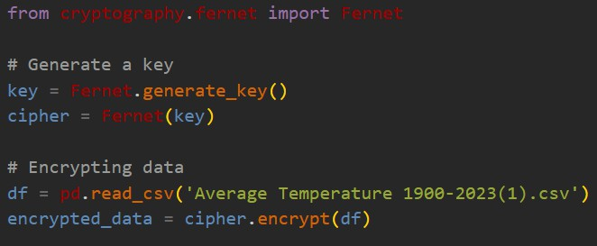
Python Cryptography
11 / 15
Measures
Python Cryptography is a encryption technique in Python which generates a key that encrypts datasets before saving them to the disk on your device

Slide 12
Streamlit Application
%

Slide 13


Challenges
Size of Datasets
The datasets were quite small thus leading to overfitting of the models
Utilizing the Spatial Data
GIS spatial data was challenging to use due to the large size and how demanding it is to run on a computer

Slide 14
Lessons Learnt
Handling Large datasets
Cleaning and preprocessing complex data, including handling missing values and outliers
Integrating Machine Learning and GIS
Combining spatial data with predictive modeling to understand both spatial and temporal trends

Slide 15
thank you
Q/A

